Slide 1


Enhanced L&MT TOOLS RENTAL System
2023/12

Slide 2
OUR TEAM
Liping Wang, Ting Cheng, Mint
P
A
D
C

Slide 3

CONTENTS
4
2
DOCUMENT
DESIGN
3
1
DEMO
INTRO

Slide 4
1
INTRODUCTION
part
Part 1

Slide 5
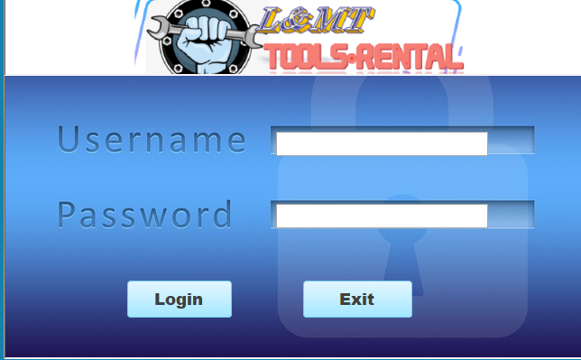
Objectives: Enhanced tracking of employee roles and history
Integrating Microsoft Access with Oracle 19c for enhanced data management.
The project involves enhancing three original tables by creating Oracle views and implementing triggers and stored procedures for INSERT, UPDATE, and DELETE operations. The aim is to maintain a history of changes in the database, specifically focusing on multi-valued fields. There's an emphasis on understanding and implementing views that replace original tables and on maintaining a history of field changes with timestamps.

Slide 6
Business Rules
1. The proposed system is an all-in-one tool rental and order management platform that comprises four fundamental component Order Confirmation Rules:
a. Confirm all orders with customers, providing an estimated delivery or pickup time.
b. Orders should be verified against the customer's original request to avoid errors.
2. Payment Processing Rules:
a. Process payments securely, ensuring sensitive customer payment information is protected.
b. Issue invoices or receipts for completed orders, and maintain records of all financial transactions
3. Returns and Refunds Rules:
a. Maintain a well-defined policy for handling returns and issuing refunds.
b. Handle return requests professionally and in compliance with local regulations.
4. Inventory Management Rules:
a. Implement a system for real-time inventory tracking and automatic restocking to prevent stockouts.
b. Periodically conduct physical inventory audits to ensure data accuracy.
5. Security and Data Protection Rules:
a. Implement robust security measures to protect customer data, payment information, and order records.
b. Conduct regular security audits and stay compliant with data protection regulations.

Slide 7
2
DESIGN
part
Part 1

Slide 8
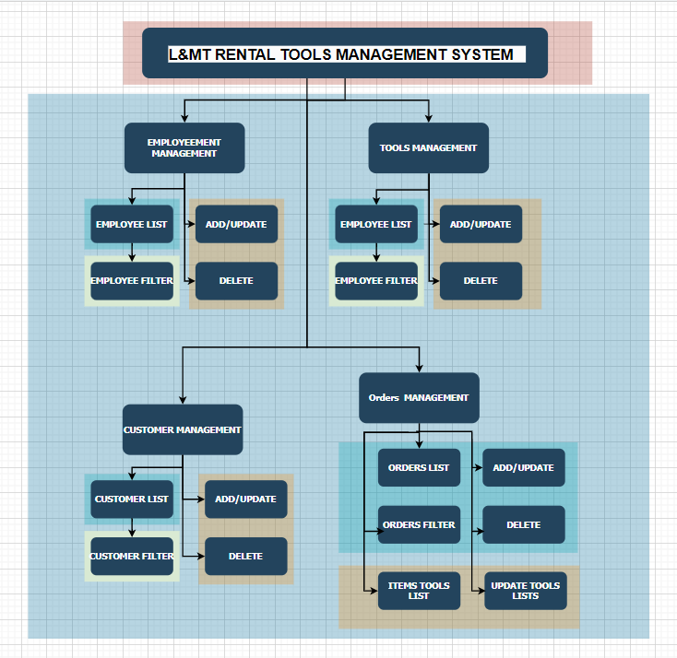
L&MT RENTAL TOOLS？

Slide 9
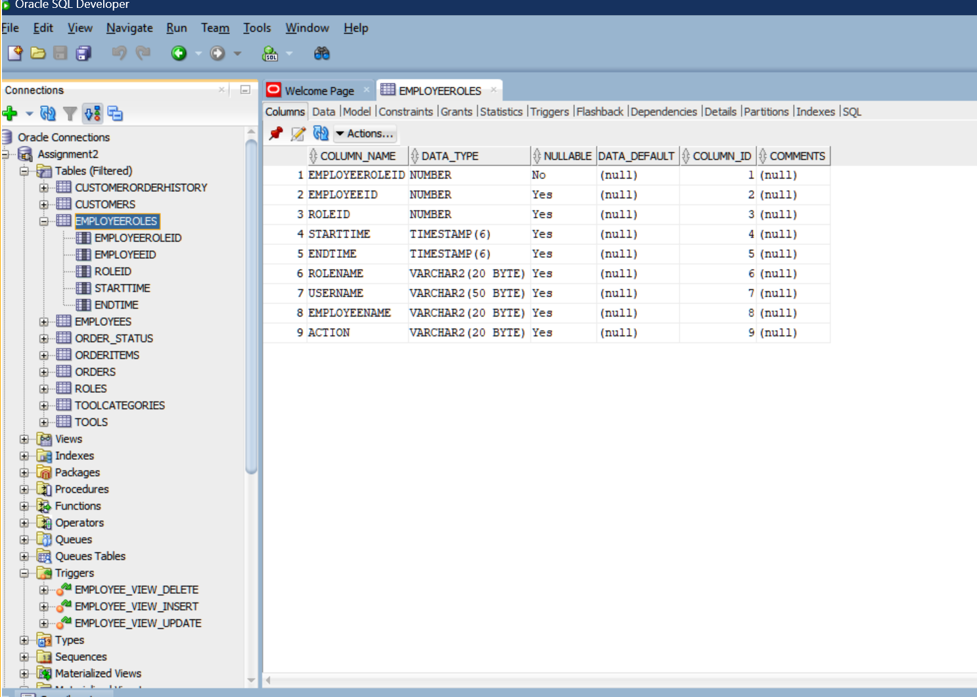
Database Schema AND Table Descriptions:
There are 10 tables for assign2 in which create 2 new tables comparing to assign1.
The most important table is the EmployeeRoles table that can record the history of employee’s role variation.

Slide 10
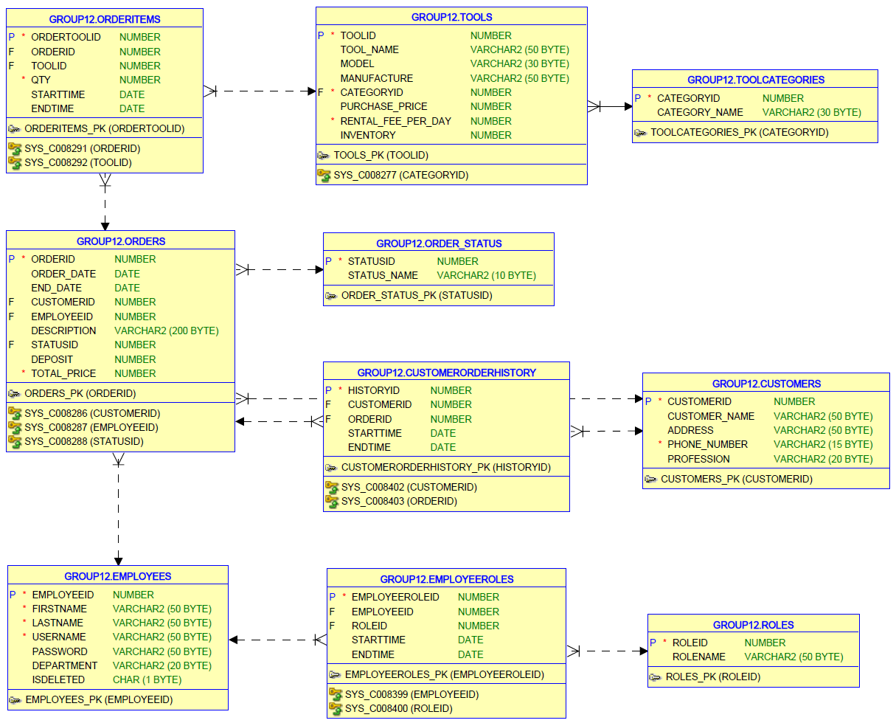
Managing Historical Data
1. Is-a Relationship
This type of relationship represents a hierarchical link between a more general category and a more specific instance. For instance, you could have different types of Employees (like 'Manager', 'Salesperson', etc.) and add a historical data field to track their Roles changes over time.
2. Contains Relationship
A "Contains" relationship implies one entity holds or includes another. In our schema, Orders containing OrderItems is a good example. The historical data field here could be related to changes in order content over time.
3. Is-related-to Relationship
This is a more general type of relationship where two entities are associated but not in a hierarchical or containment way. In our schema, the relationship between Customers and Orders is a good example. A historical data field here could be something that tracks changes in customer behavior or order patterns.

Slide 11
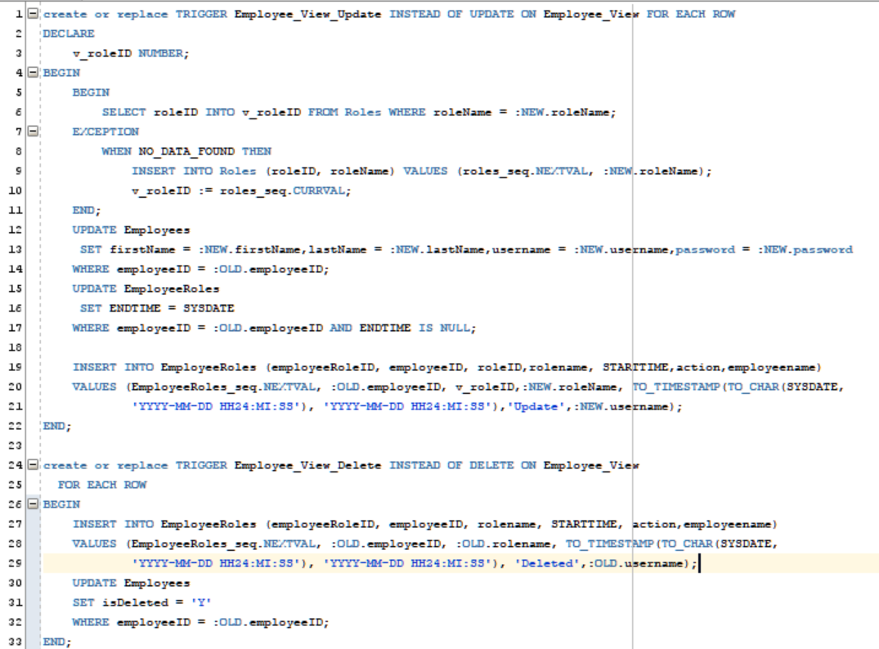
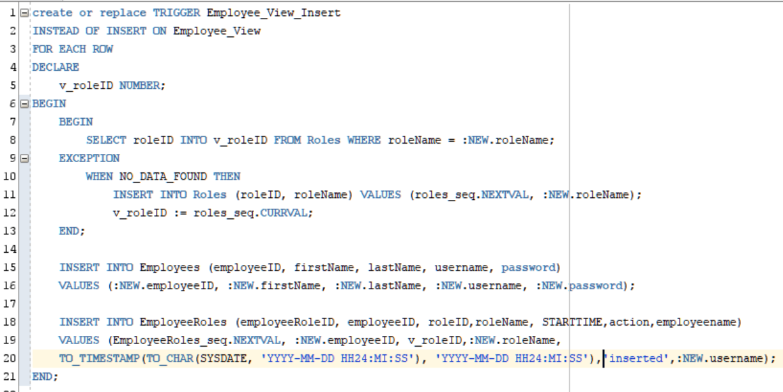
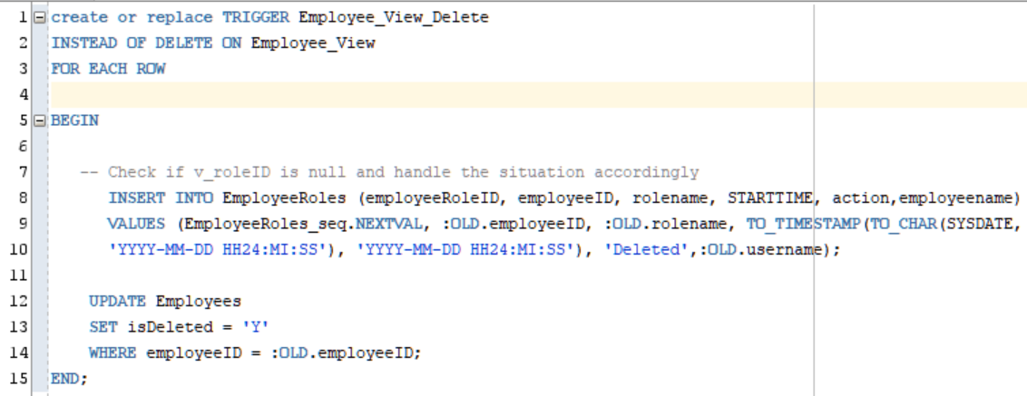
Trigger Implementation:
For “is-a ”relationship, 3 types of trigger to trace the history alternation

Slide 12
3
APPLICATION
DEMO
part
Part 1

Slide 13

DEMO
DATABASE
DESIGN
TRIGGER
CREATION
APPLICATION
IMPLEMENT
DOCUMENT
RECORD

Slide 14
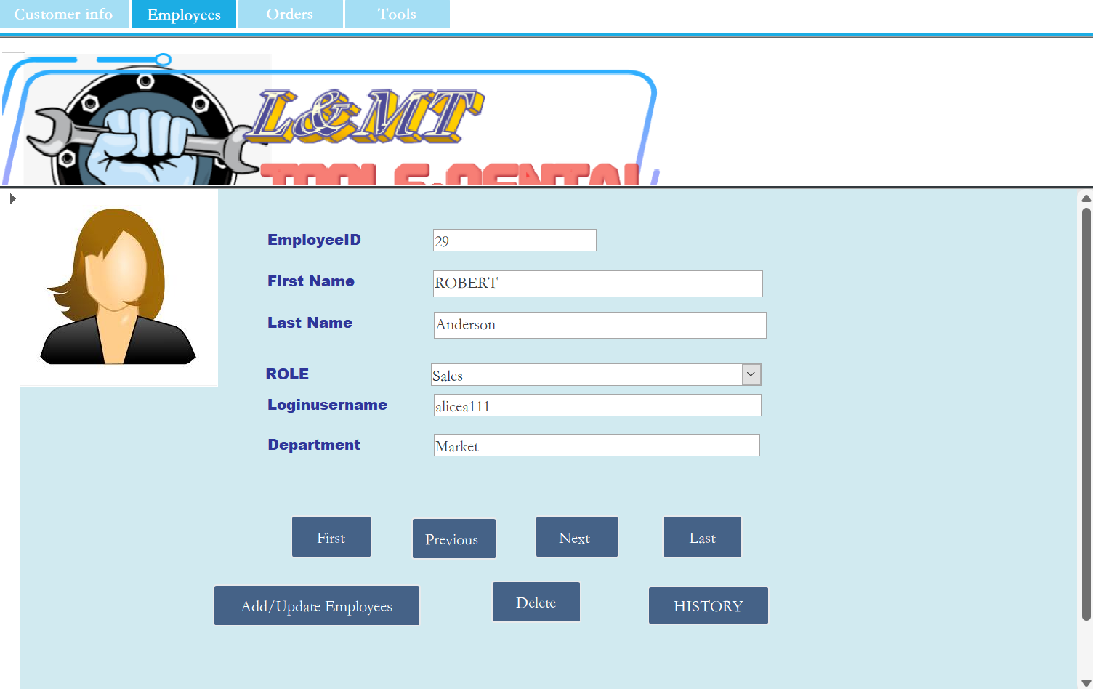
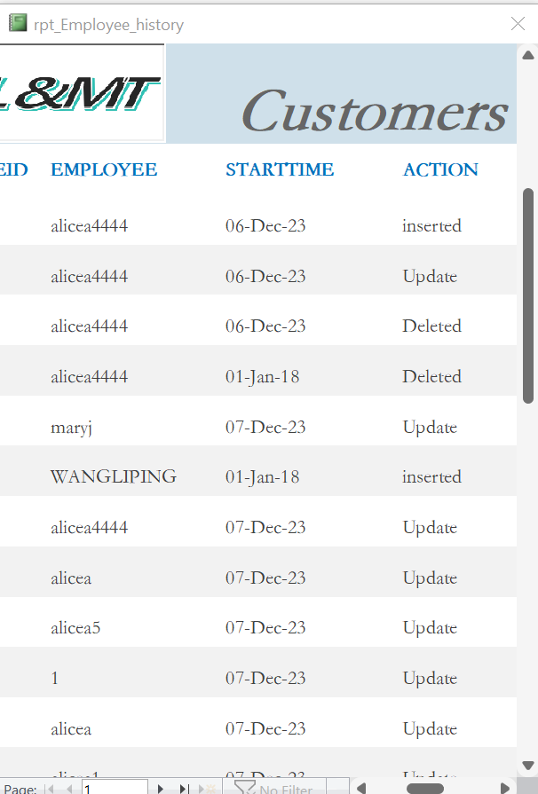

DEMO

Slide 15
4
DOCUMENTS
part
Part 1

Slide 16
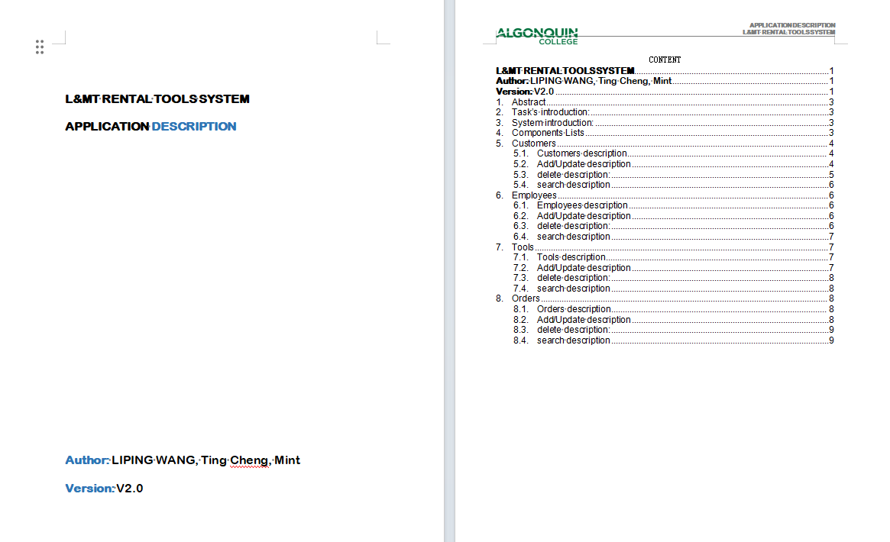
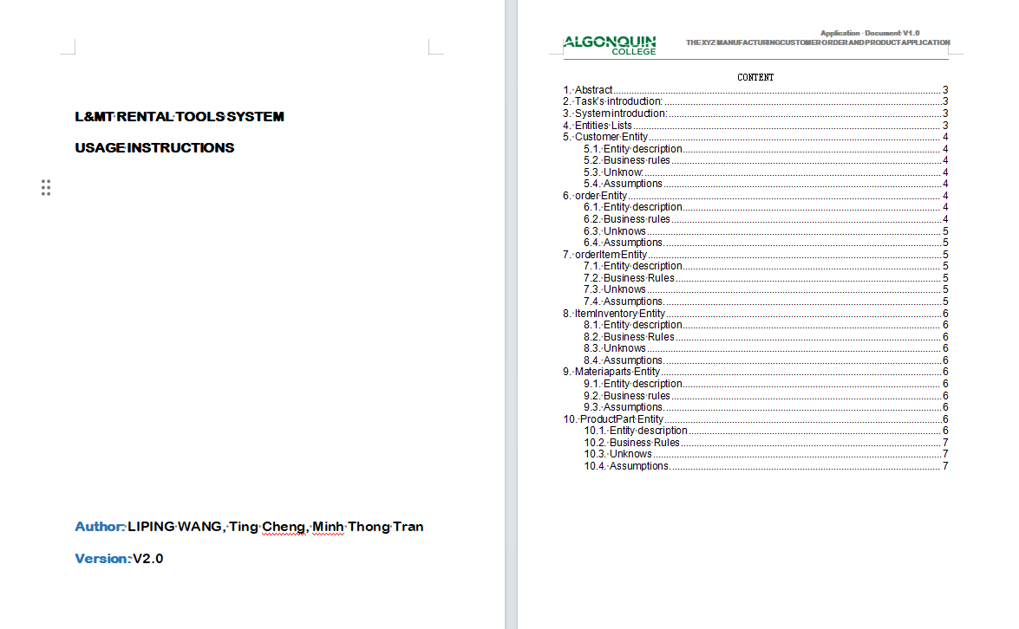
Supported Documents

